Slide 1
Module-III
CSET333: Problem Solving Using C

Slide 2
File Handling in C
File handling in C is the process in which we create, open, read, write, and close operations on a file. C language provides different functions such as fopen(), fwrite(), fread(), fseek(), fprintf(), etc. to perform input, output, and many different C file operations in our program.
In order to understand why file handling is important, let us look at a few features of using files:
Reusability: The data stored in the file can be accessed, updated, and deleted anywhere and anytime providing high reusability.
Portability: Without losing any data, files can be transferred to another in the computer system. The risk of flawed coding is minimized with this feature.
Efficient: A large amount of input may be required for some programs. File handling allows you to easily access a part of a file using few instructions which saves a lot of time and reduces the chance of errors.
Storage Capacity: Files allow you to store a large amount of data without having to worry about storing everything simultaneously in a program.
CSET333: Problem Solving Using C

Slide 3
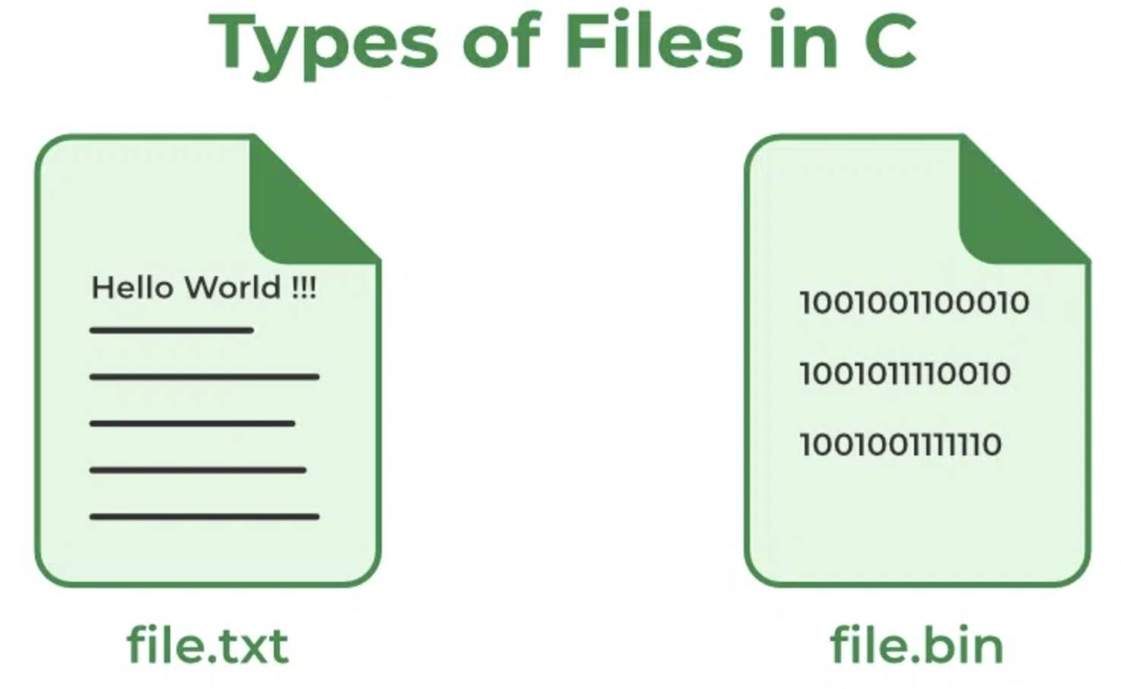
Types of Files in C
A file can be classified into two types based on the way the file stores the data. They are as follows:
  Text Files
  Binary Files
CSET333: Problem Solving Using C

Slide 4
1. Text Files
A text file contains data in the form of ASCII characters and is generally used to store a stream of characters.
  Each line in a text file ends with a new line character (‘\n’).
  It can be read or written by any text editor.
  They are generally stored with .txt file extension.
  Text files can also be used to store the source code.
2. Binary Files
A binary file contains data in binary form (i.e. 0’s and 1’s) instead of ASCII characters. They contain data that is stored in a similar manner to how it is stored in the main memory.
  The binary files can be created only from within a program and their contents can only be read by a program.
  More secure as they are not easily readable.
  They are generally stored with .bin file extension.
CSET333: Problem Solving Using C

Slide 5
C File Operations
C file operations refer to the different possible operations that we can perform on a file in C such as:
  Creating a new file – fopen() with attributes as “a” or “a+” or “w” or “w+”
  Opening an existing file – fopen()
  Reading from file – fscanf() or fgets()
  Writing to a file – fprintf() or fputs()
  Moving to a specific location in a file – fseek(), rewind()
  Closing a file – fclose()
File Pointer in C
Syntax of File Pointer
FILE* pointer_name;
File Pointer is used in almost all the file operations in C.
CSET333: Problem Solving Using C

Slide 6
Open a File in C
For opening a file in C, the fopen() function is used with the filename or file path along with the required access modes.
Syntax of fopen()
FILE* fopen(const char *file_name, const char *access_mode);
Parameters
file_name: name of the file when present in the same directory as the source file. Otherwise, full path.
access_mode: Specifies for what operation the file is being opened.
Return Value
If the file is opened successfully, returns a file pointer to it.
If the file is not opened, then returns NULL.
CSET333: Problem Solving Using C

Slide 7
Opening Modes | Description
r | Searches file. If the file is opened successfully fopen( ) loads it into memory and sets up a pointer that points to the first character in it. If the file cannot be opened fopen( ) returns NULL.
rb | Open for reading in binary mode. If the file does not exist, fopen( ) returns NULL.
w | Open for writing in text mode. If the file exists, its contents are overwritten. If the file doesn’t exist, a new file is created. Returns NULL, if unable to open the file.
wb | Open for writing in binary mode. If the file exists, its contents are overwritten. If the file does not exist, it will be created.
a | Searches file. If the file is opened successfully fopen( ) loads it into memory and sets up a pointer that points to the last character in it. It opens only in the append mode. If the file doesn’t exist, a new file is created. Returns NULL, if unable to open the file.
ab | Open for append in binary mode. Data is added to the end of the file. If the file does not exist, it will be created.
r+ | Searches file. It is opened successfully fopen( ) loads it into memory and sets up a pointer that points to the first character in it. Returns NULL, if unable to open the file.
rb+ | Open for both reading and writing in binary mode. If the file does not exist, fopen( ) returns NULL.
CSET333: Problem Solving Using C

Slide 8
Opening Modes | Description
w+ | Searches file. If the file exists, its contents are overwritten. If the file doesn’t exist a new file is created. Returns NULL, if unable to open the file.
wb+ | Open for both reading and writing in binary mode. If the file exists, its contents are overwritten. If the file does not exist, it will be created.
a+ | Searches file. If the file is opened successfully fopen( ) loads it into memory and sets up a pointer that points to the last character in it. It opens the file in both reading and append mode. If the file doesn’t exist, a new file is created. Returns NULL, if unable to open the file.
ab+ | Open for both reading and appending in binary mode. If the file does not exist, it will be created.
CSET333: Problem Solving Using C

Slide 9
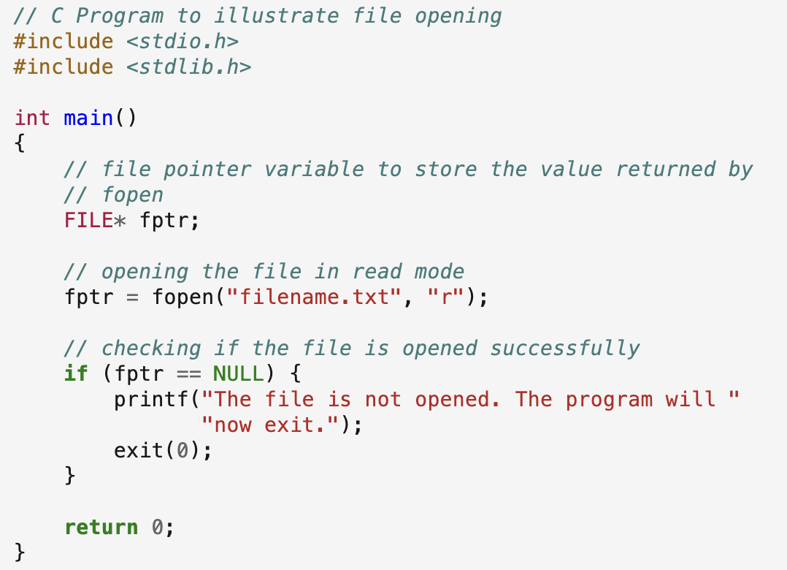
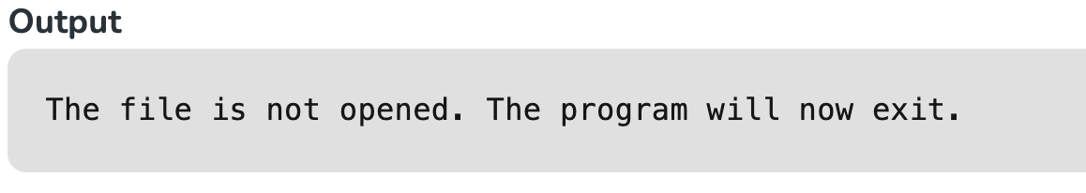
Example of Opening a File C
CSET333: Problem Solving Using C

Slide 10
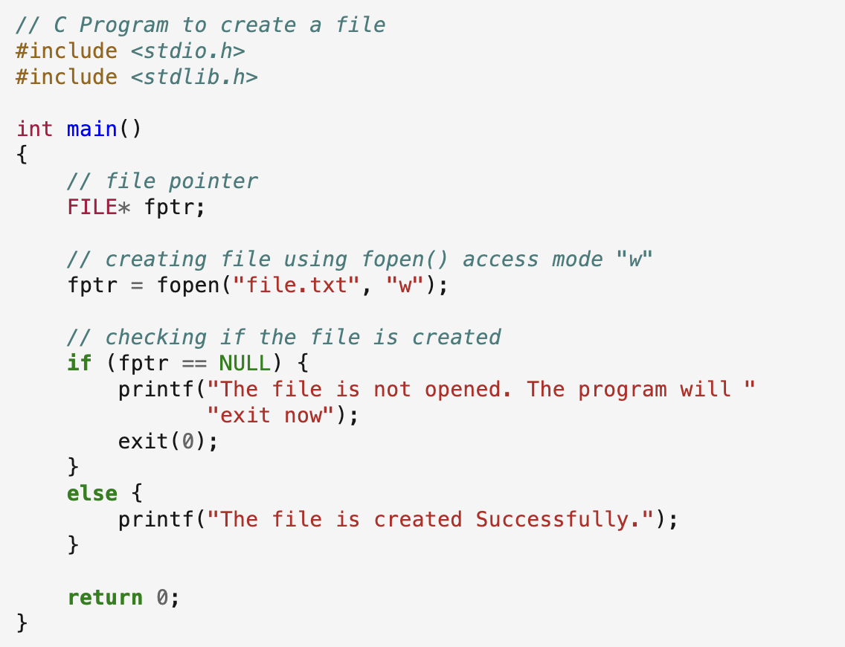
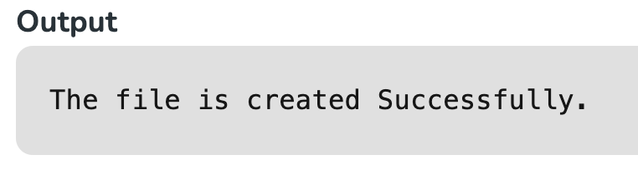
Create a File in C
The fopen() function can not only open a file but also can create a file if it does not exist already. For that, we have to use the modes that allow the creation of a file if not found such as w, w+, wb, wb+, a, a+, ab, and ab+. FILE *fptr;
fptr = fopen("filename.txt", "w");
Example
CSET333: Problem Solving Using C

Slide 11
Reading From a File
The file read operation in C can be performed using functions fscanf() or fgets(). Both the functions performed the same operations as that of scanf and gets but with an additional parameter, the file pointer. There are also other functions we can use to read from a file. Such functions are listed below:
Function | Description
fscanf() | Use formatted string and variable arguments list to take input from a file.
fgets() | Input the whole line from the file.
fgetc() | Reads a single character from the file.
fgetw() | Reads a number from a file.
fread() | Reads the specified bytes of data from a binary file.
Example:
      FILE * fptr;
      fptr = fopen(“fileName.txt”, “r”);
      fscanf(fptr, "%s %s %s %d", str1, str2, str3, &year);
      char c = fgetc(fptr);
CSET333: Problem Solving Using C

Slide 12
Write to a File
The file write operations can be performed by the functions fprintf() and fputs() with similarities to read operations. C programming also provides some other functions that can be used to write data to a file such as:
Function | Description
fprintf() | Similar to printf(), this function use formatted string and varible arguments list to print output to the file.
fputs() | Prints the whole line in the file and a newline at the end.
fputc() | Prints a single character into the file.
fputw() | Prints a number to the file.
fwrite() | This functions write the specified amount of bytes to the binary file.
Example:
      FILE *fptr ;
      fptr = fopen(“fileName.txt”, “w”);
      fprintf(fptr, "%s %s %s %d", "We", "are", "in", 2012);
      fputc("a", fptr);
CSET333: Problem Solving Using C

Slide 13
Closing a File
The fclose() function is used to close the file. After successful file operations, you must always close a file to remove it from the memory.
Syntax of fclose()
fclose(file_pointer);
where the file_pointer is the pointer to the opened file.
Example:
    FILE *fptr ;
    fptr= fopen(“fileName.txt”, “w”);
    ---------- Some file Operations -------
    fclose(fptr);
CSET333: Problem Solving Using C

Slide 14
Read and Write in a Binary File
Till now, we have only discussed text file operations. The operations on a binary file are similar to text file operations with little difference.
Opening a Binary File
To open a file in binary mode, we use the rb, rb+, ab, ab+, wb, and wb+ access mode in the fopen() function. We also use the .bin file extension in the binary filename.
Example
fptr = fopen("filename.bin", "rb");
CSET333: Problem Solving Using C

Slide 15
Write to a Binary File
We use fwrite() function to write data to a binary file. The data is written to the binary file in the from of bits (0’s and 1’s).
Syntax of fwrite()
size_t fwrite(const void *ptr, size_t size, size_t nmemb, FILE *file_pointer);
Parameters:
  ptr: pointer to the block of memory to be written.
  size: size of each element to be written (in bytes).
  nmemb: number of elements.
  file_pointer: FILE pointer to the output file stream.
Return Value:
  Number of objects written.
CSET333: Problem Solving Using C

Slide 16
Reading from Binary File
The fread() function can be used to read data from a binary file in C. The data is read from the file in the same form as it is stored i.e. binary form.
Syntax of fread()
size_t fread(void *ptr, size_t size, size_t nmemb, FILE *file_pointer);
Parameters:
  ptr: pointer to the block of memory to read.
  size: the size of each element to read(in bytes).
  nmemb: number of elements.
  file_pointer: FILE pointer to the input file stream.
Return Value:
  Number of objects written.
CSET333: Problem Solving Using C

Slide 17
Functions | Description
fopen() | It is used to create a file or to open a file.
fclose() | It is used to close a file.
fgets() | It is used to read a file.
fprintf() | It is used to write blocks of data into a file.
fscanf() | It is used to read blocks of data from a file.
getc() | It is used to read a single character to a file.
putc() | It is used to write a single character to a file.
fseek() | It is used to set the position of a file pointer to a mentioned location.
ftell() | It is used to return the current position of a file pointer.
rewind() | It is used to set the file pointer to the beginning of a file.
putw() | It is used to write an integer to a file.
getw() | It is used to read an integer from a file.
CSET333: Problem Solving Using C

Slide 18
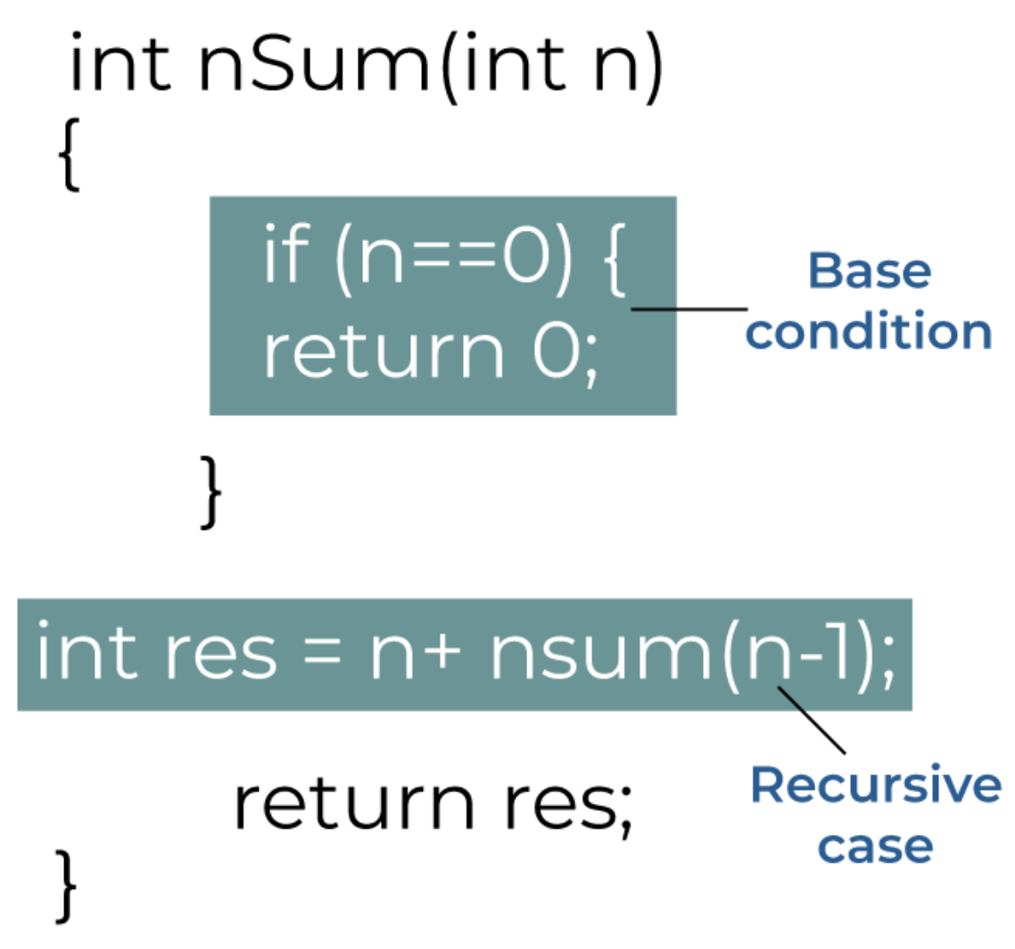
Recursive Functions in C
Basic Structure of Recursive Functions
The basic syntax structure of the recursive functions is:
  type function_name (args) {
    // function statements
    // base condition
    // recursion case (recursive call)
  }
Fundamentals of C Recursion
  Recursion Case
  Base Condition
CSET333: Problem Solving Using C

Slide 19
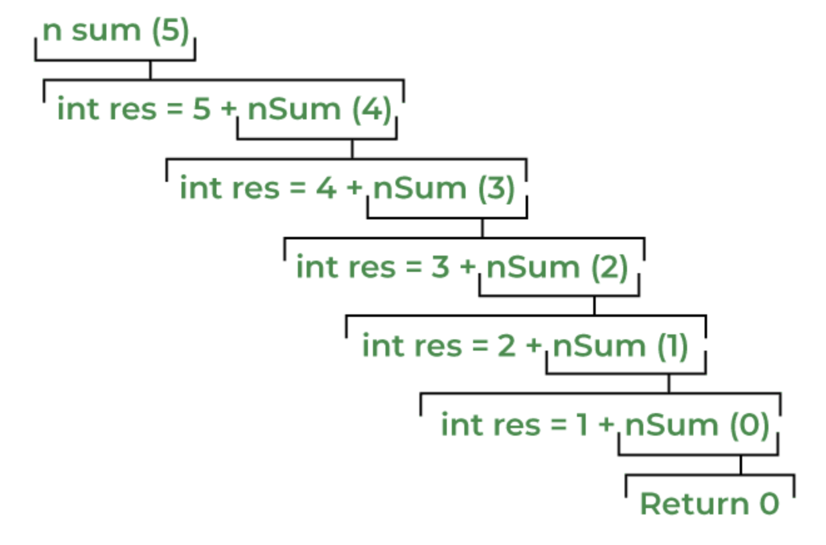
How Recursion works in C?
In the nSum() function, Recursive Case is
int res = n + nSum(n - 1);
CSET333: Problem Solving Using C

Slide 20
Types of C Recursion
In C, recursion can be classified into different types based on what kind of recursive case is present. These types are:
Direct Recursion
  Head Recursion
  Tail Recursion
  Tree Recursion
Indirect Recursion
1. Direct Recursion
Direct recursion is the most common type of recursion, where a function calls itself directly within its own body. The recursive call can occur once or multiple times within the function due to which we can further classify the direct recursion
A. Head Recursion
The head recursion is a linear recursion where the position of its only recursive call is at the start of the function. It is generally the first statement in the function.
CSET333: Problem Solving Using C

Slide 21
B. Tail Recursion
The tail recursion is also a liner recursion like head recursion but the position of the recursive call is at the end of the function. Due to this, the tail recursion can be optimized to minimize the stack memory usage. This process is called Tail Call Optimization.
In the first example, the nSum() does the tail recursion.
C. Tree Recursion
In tree recursion, there are multiple recursive calls present in the body of the function. Due to this, while tracing the program flow, it makes a tree-like structure, hence the name Tree Recursion.
2. Indirect Recursion
Indirect recursion is an interesting form of recursion where a function calls another function, which eventually calls the first function or any other function in the chain, leading to a cycle of function calls. In other words, the functions are mutually recursive. This type of recursion involves multiple functions collaborating to solve a problem.
CSET333: Problem Solving Using C

Slide 22
Advantages of C Recursion
The advantages of using recursive methods over other methods are:
  Recursion can effectively reduce the length of the code.
  Some problems are easily solved by using recursion like the tower of Hanoi and tree traversals.
  Data structures like linked lists, trees, etc. are recursive by nature so recursive methods are easier to implement for these data structures.
Disadvantages of C Recursion
As with almost anything in the world, recursion also comes with certain limitations some of which are:
  Recursive functions make our program a bit slower due to function call overhead.
  Recursion functions always take extra space in the function call stack due to separate stack frames.
  Recursion methods are difficult to understand and implement.
CSET333: Problem Solving Using C

Slide 23
Memory Allocation for C Recursive Function
A stack frame is created on top of the existing stack frames each time a recursive call is encountered and the data of each recursive copy of the function will be stored in their respective stack.
Once, some value is returned by the function, its stack frame will be destroyed.
The compiler maintains an instruction pointer to store the address of the point where the control should return in the function after its progressive copy returns some value. This return point is the statement just after the recursive call.
After all the recursive copy returned some value, we come back to the base function and the finally return the control to the caller function.
CSET333: Problem Solving Using C

Slide 24
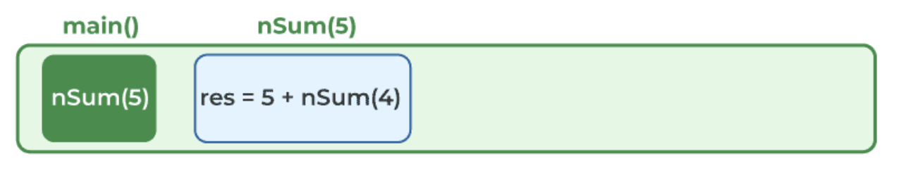
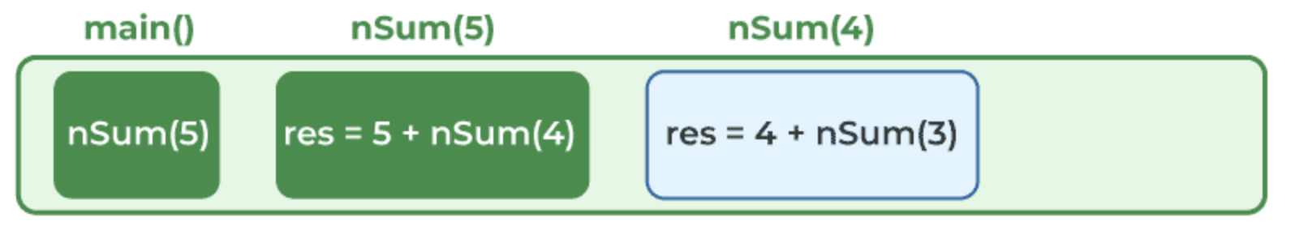
Let’s use the first example again and see how the memory is managed for the nSum() function.
Step 1:
When nSum() is called from the main() function with 5 as an argument, a stack frame for nSum(5) is created.
Step 2:
While executing nSum(5), a recursive call is encountered as nSum(4). The compiler will now create a new stack frame on top of the nSum(5)’s stack frame and maintain an instruction pointer at the statement where nSum(4) was encountered.
Step 3:
In the execution of nSum(4), we encounter another recursive call as nSum(3). The compiler will again follow the same steps and maintain another instruction pointer and stack frame for nSum(3).
CSET333: Problem Solving Using C

Slide 25
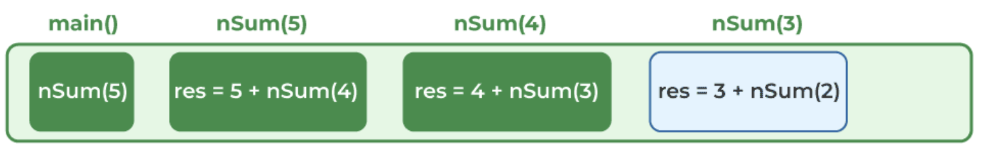
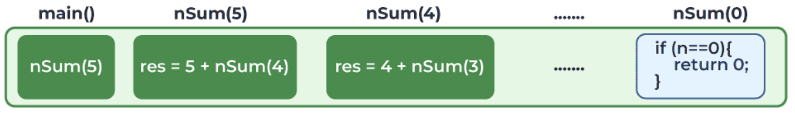
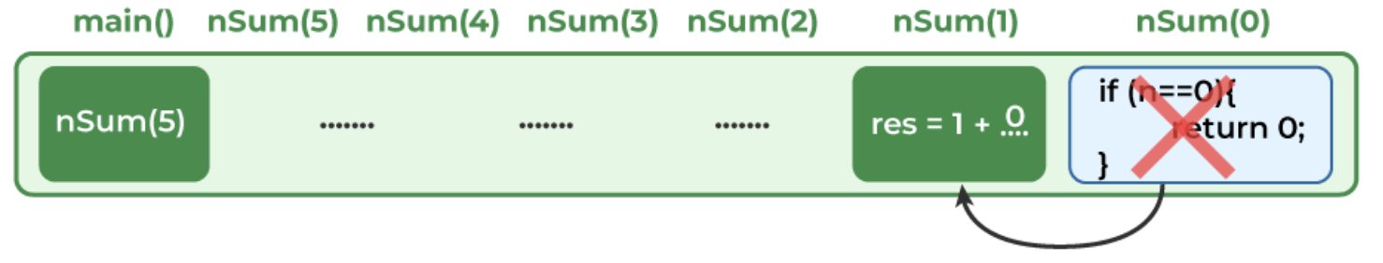
Step 4:
The same thing will happen with nSum(3), nSum(2), and nSum(1)’s execution.
Step 5:
But when the control comes to nSum(0), the condition (n == 0) becomes true and the statement return 0 is executed.
Step 6:
As the value is returned by the nSum(0), the stack frame for the nSum(0) will be destroyed. Using the instruction pointer, the program control will return to the nSum(1) function and the nSum(0) call will be replaced by value 0.
CSET333: Problem Solving Using C

Slide 26
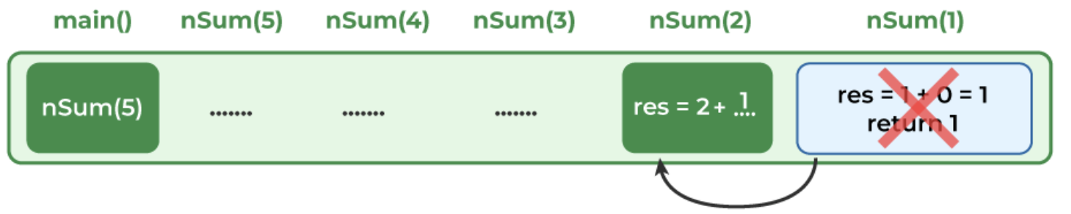
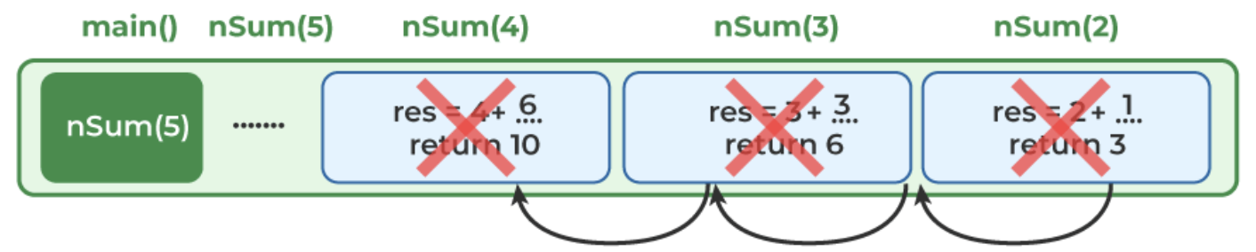
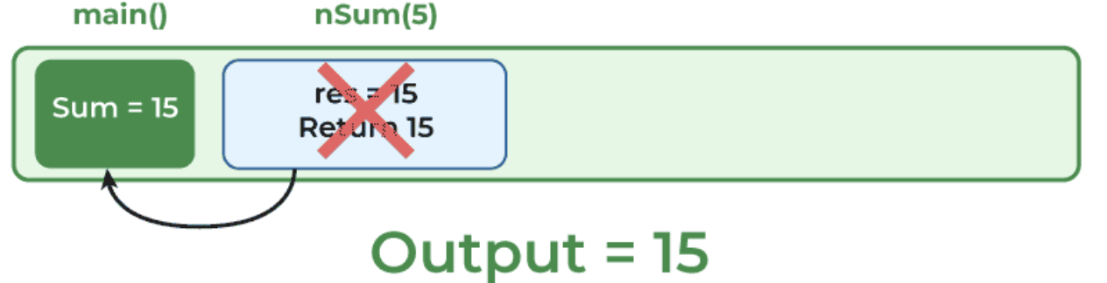
Step 7:
Now, in nSum(1), the expression int res = 1 + 0 will be evaluated and the statement return res will be executed. The program control will move to the nSum(2)
Step 8:
In nSum(2), nSum(1) call will be replaced by the value it returned, which is 1. So, after evaluating int res = 2 + 1, 3 will be returned to nSum(3). The same thing will keep happening till the control comes to the nSum(5) again.
Step 9:
When the control reaches the nSum(5), the expression int res = 5 + nSum(4) will look like int res = 5 + 10. Finally, this value will be returned to the main() function and the execution of nSum() function will be completed.
CSET333: Problem Solving Using C

Slide 27
Dynamic Memory Allocation in C
There are 4 library functions provided by C defined defined under <stdlib.h> header file to facilitate dynamic memory allocation in C programming.
They are:
  malloc()
  calloc()
  free()
  realloc()
CSET333: Problem Solving Using C

Slide 28
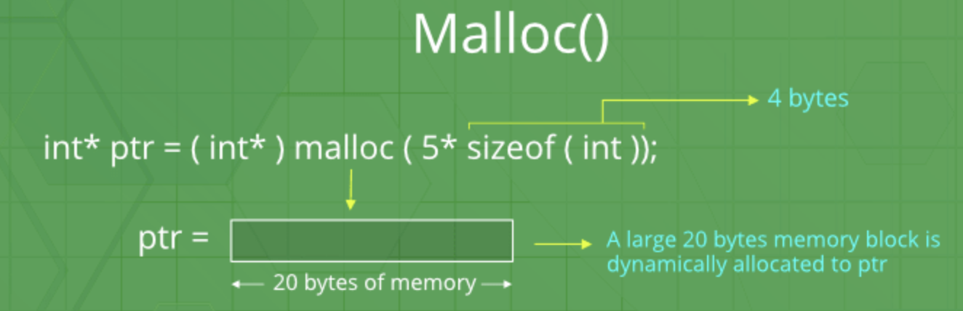
C malloc() method
Syntax of malloc() in C
ptr = (cast-type*) malloc(byte-size)
For Example:
ptr = (int*) malloc(100 * sizeof(int));
Since the size of int is 4 bytes, this statement will allocate 400 bytes of memory. And, the pointer ptr holds the address of the first byte in the allocated memory.
CSET333: Problem Solving Using C

Slide 29
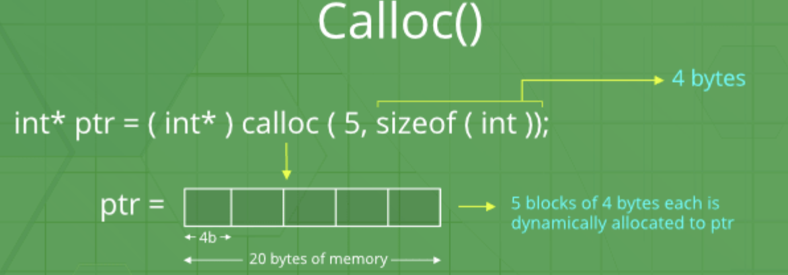
C calloc() method
“calloc” or “contiguous allocation” method in C is used to dynamically allocate the specified number of blocks of memory of the specified type. it is very much similar to malloc() but has two different points and these are:
It initializes each block with a default value ‘0’.
It has two parameters or arguments as compare to malloc().
Syntax of calloc() in C
ptr = (cast-type*)calloc(n, element-size);
here, n is the no. of elements and element-size is the size of each element.
CSET333: Problem Solving Using C

Slide 30
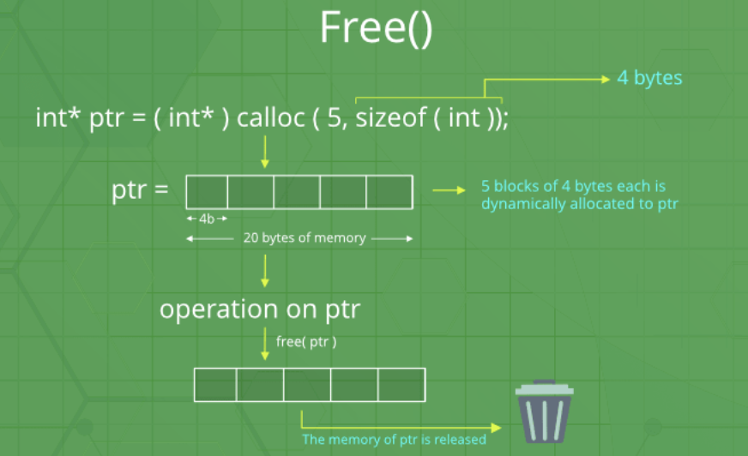
C free() method
“free” method in C is used to dynamically de-allocate the memory. The memory allocated using functions malloc() and calloc() is not de-allocated on their own. Hence the free() method is used, whenever the dynamic memory allocation takes place. It helps to reduce wastage of memory by freeing it.
Syntax of free() in C
free(ptr);
CSET333: Problem Solving Using C

Slide 31
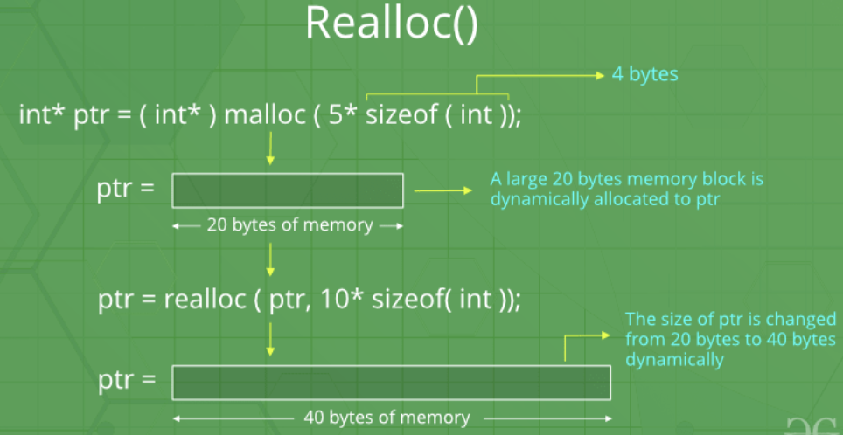
C realloc() method
“realloc” or “re-allocation” method in C is used to dynamically change the memory allocation of a previously allocated memory. In other words, if the memory previously allocated with the help of malloc or calloc is insufficient, realloc can be used to dynamically re-allocate memory. re-allocation of memory maintains the already present value and new blocks will be initialized with the default garbage value.
Syntax of realloc() in C
ptr = realloc(ptr, newSize);
where ptr is reallocated with new size 'newSize'.
CSET333: Problem Solving Using C

Slide 32
Introduction to Memory in C
Two primary types of memory:
  Global Memory
  Local Memory
What is Local Memory?
  Memory allocated within a function or block.
  Scope: Limited to the function where it’s declared.
  Lifetime: Only exists during the execution of the function.
Example: void myFunction()
{int localVar = 10; // local memory}
What is Global Memory?
  Memory allocated outside all functions, often at the file level.
  Scope: Available across the entire program.
  Lifetime: Exists throughout the program's execution.
Example: int globalVar = 20; // global memory
void myFunction() {
// can access globalVar here}
CSET333: Problem Solving Using C

Slide 33
Characteristics of Local Memory | Characteristics of Global Memory
Stored on the stack. | Stored in the data segment (or BSS if uninitialized).
Automatically deallocated when the function exits. | Accessible from any function within the program.
Faster access due to proximity to CPU. | Remains in memory throughout program execution.
Each function call has its own copy of the local variable. | Can lead to side effects when modified globally.
Not accessible outside the defining function. | Increases the risk of naming conflicts.
Pros of Local Memory | Pros of Global Memory
Encapsulation: Variables are hidden within the function. | Useful for data that needs to be shared across multiple functions.
Memory efficiency: Freed after the function is executed. | Persists throughout the entire program.
Reduces the risk of accidental modifications from other parts of the program. | Convenient when dealing with configuration or constant data.
CSET333: Problem Solving Using C

Slide 34
Cons of Local Memory | Cons of Global Memory
Can’t maintain state across function calls. | Hard to manage: Global variables can be accidentally modified.
Not suitable for data that needs to persist after function completion. | Can lead to naming collisions and debugging difficulties.
Stack overflow risk if too much local memory is allocated. | Memory waste: Remains allocated even when not needed.
Stack vs Data Segment
Local Memory:
  Stored in the stack.
  LIFO (Last In, First Out) memory management.
Global Memory:
  Stored in the data segment.
  Persistent allocation.
CSET333: Problem Solving Using C

Slide 35
Error Handling in C
A lot of C function calls return -1 or NULL or set an in case of an error code as the global variable errno, so quick tests on these values are easily done with an instance of ‘if statement’.
What is errno?
errno is a global variable indicating the error occurred during any function call and it is defined inside <errno.h> header file.
When a function is called in C, a variable named errno is automatically assigned a code (value) which can be used to identify the type of error that has been encountered. Different codes (values) for errno mean different types of errors.
CSET333: Problem Solving Using C

Slide 36
errno value | Error | errno value | Error
1 | Operation not permitted | 8 | Exec format error
2 | No such file or directory | 9 | Bad file number
3 | No such process | 10 | No child processes
4 | Interrupted system call | 11 | Try again
5 | I/O error | 12 | Out of memory
6 | No such device or address | 13 | Permission denied
7 | The argument list is too long
CSET333: Problem Solving Using C

Slide 37
Different Methods for Error Handling in C
Different methods are used to handle different kinds of errors in C. Some of the commonly used methods are:
  perror()
  strerr()
  ferror()
  feof()
  clearerr()
  Exit Status
  Divide by Zero Error
1. perror()
The perror() function is used to show the error description. It displays the string you pass to it, followed by a colon, a space, and then the textual representation of the current errno value.
Syntax
void perror(const char *str);
Parameters
str: It is a string containing a custom message to be printed before the error message itself.
CSET333: Problem Solving Using C

Slide 38
2. strerror()
The strerror() function is also used to show the error description. This function returns a pointer to the textual representation of the current errno value.
Syntax
char *strerror(int errnum);
Parameters
errnum: It is the error number (errno).
3. ferror()
The ferror() function is used to check whether an error occurred during a file operation.
Syntax
int ferror(FILE *stream);
Parameters
stream: It is the pointer that points to the FILE for which we want to check the error.
Return Value
It returns a non-zero value if an error occurred, otherwise it returns 0.
CSET333: Problem Solving Using C

Slide 39
4. feof()
The feof() function is used to check whether end-of-file indicator is set for a file steam.
Syntax
int feof(FILE *stream);
Parameters
stream: It is the pointer that points to the FILE for which we want to check the error.
Return Value
It returns a non-zero value if an error occurred, otherwise, it returns 0.
5. clearerr()
The clearerr() function is used to clear both end-of-file and error indicators for a file stream.
Syntax
void clearerr(FILE *stream);
Parameters
stream: It is the pointer that points to the FILE for which we want to check the error.
CSET333: Problem Solving Using C

Slide 40
6. Exit Status
Exit status is the value returned by the program after its execution is completed which tells the status of the execution of the program.
The C standard specifies two constants: EXIT_SUCCESS and EXIT_FAILURE, that may be passed to exit() to indicate successful or unsuccessful termination, respectively. These are macros defined in <stdlib.h> header file.
7. Divide by Zero Errors
A common pitfall made by C programmers is not checking if a divisor is zero before a division command. Division by zero leads to undefined behavior, there is no C language construct that can do anything about it. Your best bet is to not divide by zero in the first place, by checking the denominator.
CSET333: Problem Solving Using C

Slide 41
Calling C functions from Python
Why Call C from Python?
  Performance: Python is slower than C in performance-critical tasks.
  Use of Legacy Code: Reuse existing C code.
  Low-level System Access: Use system-level libraries directly from Python.
Methods to Call C from Python
  ctypes: Standard Python library to call C functions directly.
  CFFI: C Foreign Function Interface, providing a more Pythonic approach.
  SWIG: Simplifies wrapping C/C++ code.
  Python C API: Directly embed C code in Python, most powerful but complex.
CSET333: Problem Solving Using C

Slide 42
Using ctypes
Overview: Allows calling functions from dynamic/shared libraries (DLLs/SOs).
Key Steps:
  Load the shared library using ctypes.CDLL or ctypes.PyDLL.
  Define C function signatures in Python using ctypes types.
  Call the function just like a Python function.
Example:
      import ctypes
      # Load shared C library
      lib = ctypes.CDLL('./libexample.so')
      # Define argument and return types for the C function
      lib.add_integers.argtypes = (ctypes.c_int, ctypes.c_int)
      lib.add_integers.restype = ctypes.c_int
      # Call the function
      result = lib.add_integers(3, 5)
      print(result) # Output: 8
CSET333: Problem Solving Using C

Slide 43
Using CFFI
Overview: A more user-friendly alternative to ctypes.
Key Steps:
  Define C functions in Python using ffi.cdef().
  Load the C library using ffi.dlopen().
  Call the function like a regular Python method.
Example:
      from cffi import FFI
      ffi = FFI()
      ffi.cdef("int add_integers(int, int);")
      lib = ffi.dlopen('./libexample.so')
      result = lib.add_integers(3, 5)
      print(result) # Output: 8
Using SWIG
Overview: SWIG generates wrapper code for calling C/C++ from various languages.
Steps:
  Write C code and header file.
  Create an interface file (.i file).
  Use SWIG to generate Python wrapper.
  Compile the wrapper and link with the C code.
CSET333: Problem Solving Using C

Slide 44
Python C API
Overview: Provides direct control over Python objects in C.
When to Use: For tight integration between Python and C with optimal performance.
Disadvantages: More complex, requires writing a Python extension module.
Example:
Write a C function
Build as a Python extension using setuptools
Import and use the C function as a Python module
// example.c
#include <Python.h>
static PyObject* add_integers(PyObject* self, PyObject* args) {
int a, b;
if (!PyArg_ParseTuple(args, "ii", &a, &b)) {
return NULL;
}
return PyLong_FromLong(a + b);
}
CSET333: Problem Solving Using C

Slide 45
Calling python functions from C
Why Call Python from C?
  Scripting Capabilities: Embed Python to add scripting functionality to C programs.
  Leverage Python Libraries: Access Python’s extensive ecosystem (e.g., NumPy, Pandas).
  Rapid Prototyping: Execute Python logic without rewriting C code.
Python C API Overview
  The Python/C API allows C programs to call Python functions.
  Embedding Python: This is embedding the Python interpreter into a C program.
  Interpreter Lifecycle:
    Initialize the Python interpreter.
    Execute Python code.
    Finalize the interpreter.
CSET333: Problem Solving Using C

Slide 46
Setup: Include Python Headers
Include the necessary Python headers:
#include <Python.h>
Initializing the Python Interpreter
Key Function: Py_Initialize()
  #include <Python.h>
  int main() {
  Py_Initialize(); // Initialize Python Interpreter
  // Your code to call Python functions goes here
  Py_Finalize(); // Finalize the interpreter when done
  return 0;
  }
CSET333: Problem Solving Using C

Slide 47
Steps to Call Python from C
Initialize the Python Interpreter: Py_Initialize()
Import Python Module: PyImport_ImportModule()
Get Python Function: PyObject_GetAttrString()
Call Python Function: PyObject_CallObject()
Handle Return Values: Use Python C API to process Python results.
Finalize the Interpreter: Py_Finalize()
Example Code Structure
  #include <Python.h>
  int main() {
  // Initialize the Python Interpreter
  Py_Initialize();
  // Import the Python module (e.g., myscript.py)
  PyObject* pModule = PyImport_ImportModule("myscript");
CSET333: Problem Solving Using C

Slide 48
  if (pModule != NULL) {
  // Get the function from the module
  PyObject* pFunc = PyObject_GetAttrString(pModule, "my_function");
  if (pFunc && PyCallable_Check(pFunc)) {
  // Call the function with arguments
  PyObject* pValue = PyObject_CallObject(pFunc, NULL);
  // Process the returned value
  if (pValue != NULL) {
  printf("Return value: %ld\n", PyLong_AsLong(pValue));
  Py_DECREF(pValue);
  }
  }
  Py_DECREF(pFunc);
  Py_DECREF(pModule);
  }
  // Finalize the Python Interpreter
  Py_Finalize();
  return 0;
  }
CSET333: Problem Solving Using C

Slide 49
Creating a thread
What is a Thread?
  A thread is the smallest unit of execution within a process.
  A process can have multiple threads sharing the same memory space.
  Multithreading allows concurrent execution of tasks within a process.
Why Use Threads?
  Concurrency: Run multiple tasks simultaneously.
  Performance: Utilize multiple CPU cores for better performance.
  Responsiveness: Keep applications responsive by offloading long-running tasks.
  Parallelism: Split large computational tasks into smaller threads for parallel processing.
CSET333: Problem Solving Using C

Slide 50
Threads operate faster than processes due to following reasons:
  1) Thread creation is much faster.
  2) Context switching between threads is much faster.
  3) Threads can be terminated easily
  4) Communication between threads is faster.
Thread vs Process
Process:
  Independent execution with its own memory space.
  Communication between processes requires inter-process communication (IPC).
Thread:
  Shares memory space with other threads in the same process.
  Lightweight compared to processes.
  Easier and faster communication between threads.
CSET333: Problem Solving Using C

Slide 51
Example:
#include <pthread.h>
#include <stdio.h>
#include <stdlib.h>
#include <unistd.h> //Header file for sleep(). man 3 sleep for details.
// A normal C function that is executed as a thread
// when its name is specified in pthread_create()
void* myThreadFun(void* vargp)
{
sleep(1);
printf("Printing GeeksQuiz from Thread \n");
return NULL;
}
int main()
{
pthread_t thread_id;
printf("Before Thread\n");
pthread_create(&thread_id, NULL, myThreadFun, NULL);
pthread_join(thread_id, NULL);
printf("After Thread\n");
exit(0);
}
CSET333: Problem Solving Using C

Slide 52
Explanation:
In main(), we declare a variable called thread_id, which is of type pthread_t, which is an integer used to identify the thread in the system. After declaring thread_id, we call pthread_create() function to create a thread.
pthread_create() takes 4 arguments.
The first argument is a pointer to thread_id which is set by this function.
The second argument specifies attributes. If the value is NULL, then default attributes shall be used.
The third argument is name of function to be executed for the thread to be created.
The fourth argument is used to pass arguments to the function, myThreadFun.
The pthread_join() function for threads is the equivalent of wait() for processes. A call to pthread_join blocks the calling thread until the thread with identifier equal to the first argument terminates.
CSET333: Problem Solving Using C

Slide 53
How to compile the given program/code?
To compile a multithreaded program using gcc, we need to link it with the pthreads library. Following is the command used to compile the program.
  gfg@ubuntu:~/$ gcc multithread.c -lpthread
  gfg@ubuntu:~/$ ./a.out
  Before Thread
  Printing GeeksQuiz from Thread
  After Thread
  gfg@ubuntu:~/$
CSET333: Problem Solving Using C

Slide 54
Passing Arguments to Threads
In C (pthreads): Use the fourth argument of pthread_create to pass data.
  void* thread_function(void* arg) {
  int* num = (int*) arg;
  printf("Thread: Number passed: %d\n", *num);
  return NULL;
  }
  int main() {
  pthread_t thread;
  int num = 10;
  pthread_create(&thread, NULL, thread_function, &num);
  pthread_join(thread, NULL);
  }
CSET333: Problem Solving Using C

Slide 55
Thread Synchronization Techniques in C
What is Thread Synchronization?
  Thread Synchronization: Ensuring that multiple threads can work together without causing race conditions or data corruption.
  Critical Section: A part of the code where shared resources are accessed, requiring protection.
Thread Synchronization Techniques
  Mutex (Mutual Exclusion)
  Semaphore
  Condition Variables
  Spinlocks
CSET333: Problem Solving Using C

Slide 56
Using Mutex in C (POSIX Threads)
A Mutex allows only one thread to access a critical section at a time, preventing race conditions.
Mutex Functions:
  pthread_mutex_init: Initialize a mutex.
  pthread_mutex_lock: Lock the mutex (enter critical section).
  pthread_mutex_unlock: Unlock the mutex (leave critical section).
  pthread_mutex_destroy: Destroy the mutex when done.
Example:
#include <pthread.h>
      #include <stdio.h>
      pthread_mutex_t lock;
      int counter = 0;
      void* thread_function(void* arg) {
      for (int i = 0; i < 100000; i++) {
      // Lock the critical section
      pthread_mutex_lock(&lock);
      counter++; // Critical section
      // Unlock the critical section
      pthread_mutex_unlock(&lock);
      }
      return NULL;}
CSET333: Problem Solving Using C

Slide 57
      int main() {
      pthread_t thread1, thread2;
      // Initialize the mutex
      pthread_mutex_init(&lock, NULL);
      // Create two threads
      pthread_create(&thread1, NULL, thread_function, NULL);
      pthread_create(&thread2, NULL, thread_function, NULL);
      // Wait for both threads to finish
      pthread_join(thread1, NULL);
      pthread_join(thread2, NULL);
      // Destroy the mutex
      pthread_mutex_destroy(&lock);
      printf("Final Counter Value: %d\n", counter);
      return 0;
      }
Key Points:
  Without Mutex: Counter value may be incorrect due to race conditions.
  With Mutex: Ensures correct and consistent counter value.
CSET333: Problem Solving Using C

Slide 58
Using Condition Variables in C
Condition Variables are used for signaling between threads.
A thread can wait for a condition to become true, and another thread can signal when that condition is met.
Condition Variable Functions:
pthread_cond_wait: Wait for a condition.
pthread_cond_signal: Signal a waiting thread.
pthread_cond_broadcast: Wake all waiting threads.
Example:
      #include <pthread.h>
      #include <stdio.h>
      pthread_mutex_t lock;
      pthread_cond_t cond;
      int ready = 0;
      void* thread_function(void* arg) {
      pthread_mutex_lock(&lock);
      while (!ready) {
      // Wait for the condition to be signaled
      pthread_cond_wait(&cond, &lock);}
CSET333: Problem Solving Using C

Slide 59
      printf("Thread received signal to proceed.\n");
      pthread_mutex_unlock(&lock);
      return NULL;
      }
      int main() {
      pthread_t thread;
      // Initialize the mutex and condition variable
      pthread_mutex_init(&lock, NULL);
      pthread_cond_init(&cond, NULL);
      // Create the thread
      pthread_create(&thread, NULL, thread_function, NULL);
      // Simulate some work before signaling the thread
      sleep(1);
      // Lock and signal the condition
      pthread_mutex_lock(&lock);
      ready = 1;
      pthread_cond_signal(&cond); // Signal the thread to proceed
      pthread_mutex_unlock(&lock);
CSET333: Problem Solving Using C

Slide 60
      // Wait for the thread to finish
      pthread_join(thread, NULL);
      // Destroy the mutex and condition variable
      pthread_mutex_destroy(&lock);
      pthread_cond_destroy(&cond);
      return 0;
      }
Key Points:
pthread_cond_wait: Waits for the condition to become true.
pthread_cond_signal: Notifies a thread waiting on the condition.
CSET333: Problem Solving Using C

